Slide 1
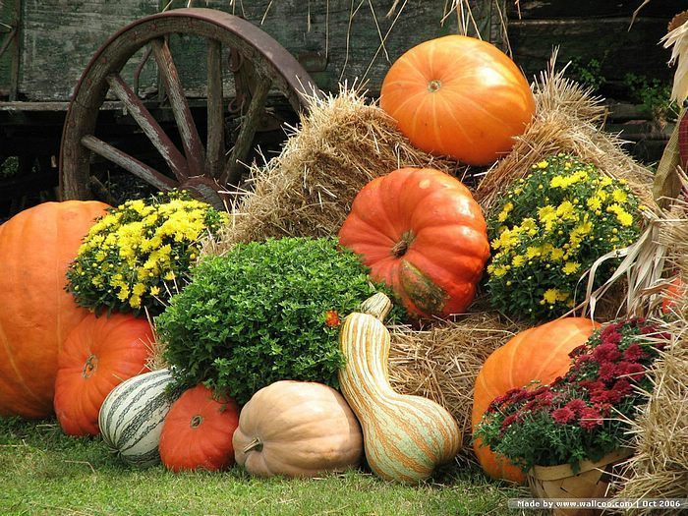
Belair Church News
November 2018
Ages 4-11
Sundays @ 10:30
Thursday, November 22nd Psalm 136:1 O give thanks unto the Lord; for he is good:
Nov 7 Spaghetti
Nov 14 Brunswick Stew
Nov 21 No Dinner
Nov 28 Shrimp Gumbo
$2.50 Person $6 Family (6:00 PM)
Ages 12-19
Sundays 4-6 PM
Mondays 8 AM
November 4th
Tuesday November 13th 10:00 AM
111111111
Belair Church 599 S. Old Belair Road Grovetown, Georgia 30813 (706) 854-9556

